Slide 1
ARITIFICAL INTELLIGENCE MVJ22CS552
MODULE 1
Prepared by:
Mrs. POSHITHA.M
AP, Dept. of CSE,
MVJCE, Bangalore

Slide 2
Course objective
This course will give ability to:
Understand fundamental concepts in Artificial Intelligence.
Analyse problem-solving techniques and knowledge representation.
Design intelligent components or programs to meet desired needs.
Implement and evaluate computer-based intelligent systems.

Slide 3
Course Outcomes
At the end of the course, the student will be able to:
CO1: Understand fundamental concepts in Artificial Intelligence.
CO2: Analyze the problem-solving techniques and knowledge representation.
CO3: Design intelligent components or programs to meet desired needs.
CO4: Implement and evaluate computer-based intelligent systems.

Slide 4
Textbook and Reference books
Textbooks:
1.Stuart Russel, Peter Norvig, “Artificial Intelligence – A Modern Approach”, Pearson Education ,3rd Edition, 2009.
2.E.Rich and K.Knight, “Artificial Intelligence”, Tata McGraw Hill ,3rd Edition, ,2008.
3. Patterson, “Artificial Intelligence and Expert Systems”, PHI, 2nd Edition, 2009.
Reference Book:
1. Ivan Bratka, “PROLOG Programming for Artificial Intelligence”, Pearson Education, 3rd Edition, 2000.

Slide 5
MODULE 1
Introduction
AI problems,
foundation of AI and history of AI,
Intelligent agents: Agents and Environments,
the concept of rationality,
the nature of environments,
Structure of agents,
Problem solving agents,
Problem formulation.

Slide 6
1.1 What Is AI?
The field of artificial intelligence, or AI, is concerned with not just understanding but also building intelligent entities—machines that can compute how to act effectively and safely in a wide variety of novel situations.
AI currently encompasses a huge variety of subfields, ranging from the general (learning, reasoning, perception, and so on) to the specific, such as playing chess, proving mathematical theorems, writing poetry, driving a car, or diagnosing diseases.
AI is relevant to any intellectual task; it is truly a universal field. We have claimed that AI is interesting, but we have not said what it is. Historically, researchers have pursued several different versions of AI.
Some have defined intelligence in terms of fidelity to human performance, while others prefer an abstract, formal definition of intelligence called rationality— loosely speaking, doing the “right thing.”

Slide 7
Artificial Intelligence is composed of two words Artificial and Intelligence,
where Artificial defines "man-made," and intelligence defines "thinking power", hence AI means "a man-made thinking power." So, we can define AI as:
"It is a branch of computer science by which we can create intelligent machines which can behave like a human, think like humans, and able to make decisions."

Slide 8
The methods used are necessarily different: the pursuit of human-like intelligence must be in part an empirical science related to psychology, involving observations and hypotheses about actual human behaviour and thought processes; a rationalist approach, on the other hand, involves a combination of mathematics and engineering, and connects to statistics, control theory, and economics. The various groups have both disparaged and helped each other.

Slide 9
Let us look at the four approaches in more detail.
Acting humanly: The Turing test approach :
The Turing test, proposed by Alan Turing (1950), was designed as a thought experiment that would sidestep the philosophical vagueness of the question “Can a machine think?”
A computer passes the test if a human interrogator, after posing some written questions, cannot tell whether the written responses come from a person or from a computer.

Slide 10
The computer would need the following capabilities:
1) Natural language processing: to communicate successfully in a human language;
2) Knowledge representation: to store what it knows or hears;
3) Automated reasoning: to answer questions and to draw new conclusions;
4)Machine learning:to adapt to new circumstances and to detect and extrapolate patterns.

Slide 11
Turing viewed the physical simulation of a person as unnecessary to demonstrate intelligence. However, other researchers have proposed a total Turing test, which requires interaction with objects and people in the real world.
To pass the total Turing test, a robot will need ......
5) Computer vision and speech recognition to perceive the world;
6) Robotics to manipulate objects and move about.

Slide 12
These six disciplines compose most of AI. Yet AI researchers have devoted little effort to passing the Turing test, believing that it is more important to study the underlying principles of intelligence.

Slide 13
Thinking humanly
The cognitive modeling approach
To say that a program thinks like a human, we must know how humans think. We can learn about human thought in three ways:
Introspection— trying to catch our own thoughts as they go by
Psychological experiments— observing a person in action
Brain imaging— observing the brain in action.

Slide 14
Once we have a sufficiently precise theory of the mind, it becomes possible to express the theory as a computer program. If the program’s input–output behaviour matches corresponding human behaviour, that is evidence that some of the program’s mechanisms could also be operating in humans.
For example, Allen Newell and Herbert Simon, who developed GPS, the “General Problem Solver” (Newell and Simon 1961), were not content merely to have their program solve problems correctly. They were more concerned with comparing the sequence and timing of its reasoning steps to those of human subjects solving the same problems.

Slide 15
Thinking rationally
The “laws of thought” approach The Greek philosopher Aristotle was one of the first to attempt to codify “right thinking”— that is, irrefutable reasoning processes. His syllogisms provided patterns for argument structures that always yielded correct conclusions when given correct premises. The canonical example starts with Socrates is a man and all men are mortal and concludes that Socrates is mortal. These laws of thought were supposed to govern the operation of the mind; their study initiated the field called logic.

Slide 16
Acting rationally: The rational agent approach
An agent is just something that acts (agent comes from the Latin agere, to do).
Of course, all computer programs do something, but computer agents are expected to do more:
Operate autonomously, perceive their environment,persist over a prolonged time period, adapt to change, and create and pursue goals

Slide 17
A rational agent is one that acts so as to achieve the best outcome or, when there is uncertainty, the best expected outcome.
In the “laws of thought” approach to AI, the emphasis was on correct inferences.
Making correct inferences is sometimes part of being a rational agent, because one way to act rationally is to deduce that a given action is best and then to act on that conclusion.
On the other hand, there are ways of acting rationally that cannot be said to involve inference.

Slide 18
The Foundations of Artificial Intelligence
In this section, we provide a brief history of the disciplines that contributed ideas, viewpoints, and techniques to AI. Like any history, this one concentrates on a small number of people, events, and ideas and ignores others that also were important.
Philosophy
• Can formal rules be used to draw valid conclusions?
• How does the mind arise from a physical brain?
• Where does knowledge come from?
• How does knowledge lead to action?

Slide 19
Mathematics
• What are the formal rules to draw valid conclusions?
• What can be computed?
• How do we reason with uncertain information?
Philosophers staked out some of the fundamental ideas of AI, but the leap to a formal science required the mathematization of logic and probability and the introduction of a new branch of mathematics: computation.
Economics
• How should we make decisions in accordance with our preferences?
• How should we do this when others may not go along?
• How should we do this when the payoff may be far in the future?

Slide 20
Neuroscience
How do brains process information?
Neuroscience is the study of the nervous system, particularly the brain. Although the exact way in which the brain enables thought is one of the great mysteries of science, the fact that it does enable thought has been appreciated for thousands of years because of the evidence that strong blows to the head can lead to mental incapacitation.
Psychology
How do humans and animals think and act?
Computer engineering
How can we build an efficient computer?

Slide 21
AI Applications
AI in Marketing
AI in Banking
AI in Finance
AI in Agriculture
AI in HealthCare

Slide 22
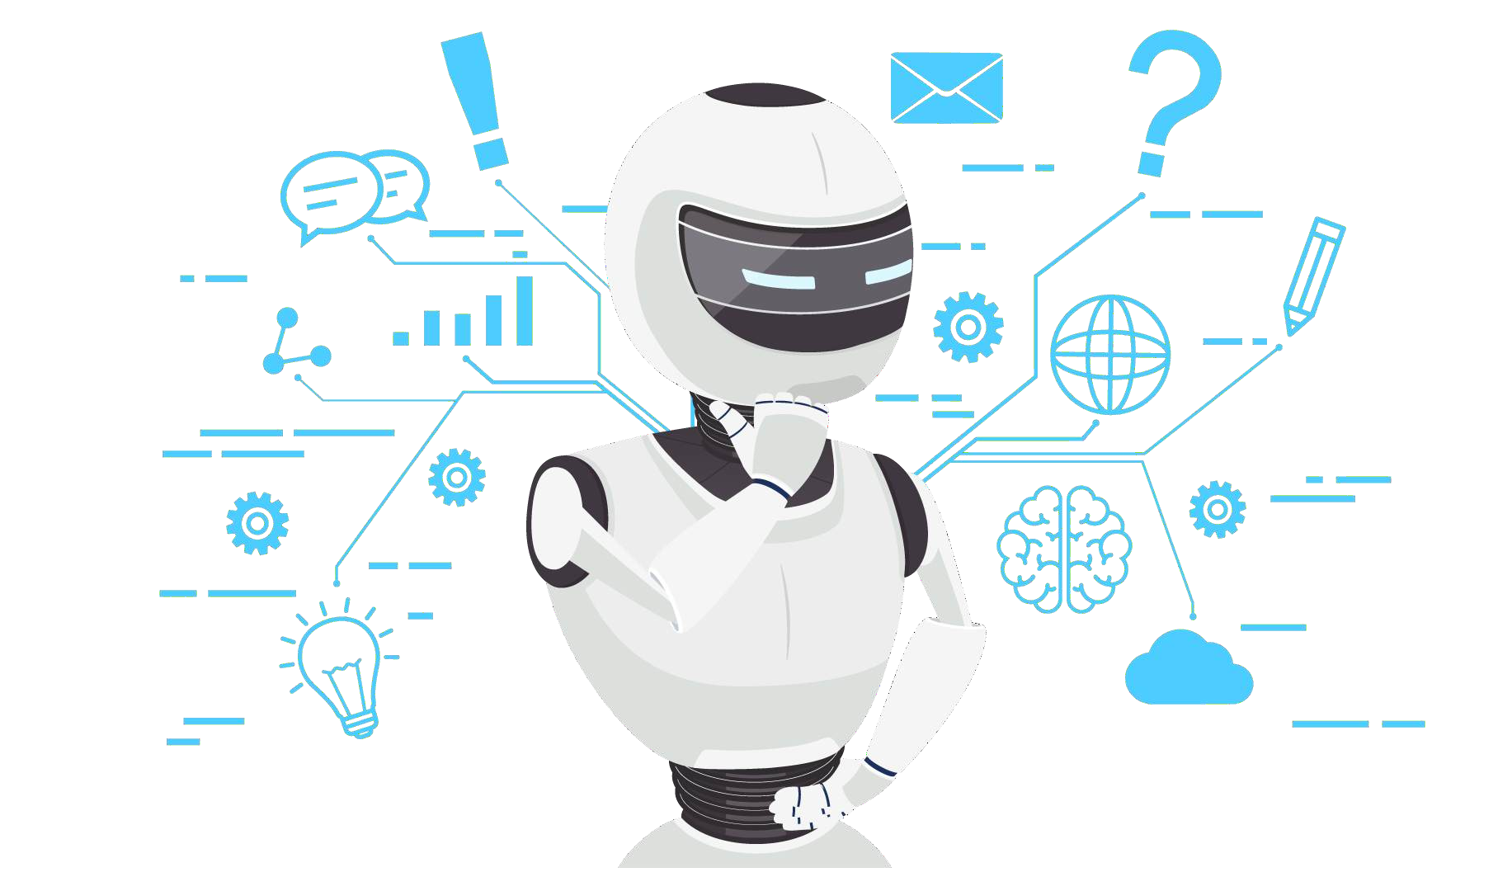
AI in Marketing
What if an algorithm or a bot is built solely for the purpose of marketing a brand or acompany? It would do a pretty awesome job!
AI in marketing refers to the application of artificial intelligence technologies to enhance marketing strategies and improve overall marketing performance.
AI tools and techniques are used to analyze data, automate tasks, personalize customer experiences, and optimize marketing campaigns.
This can lead to increased efficiency, better targeting, and improved ROI for marketing efforts.

Slide 23
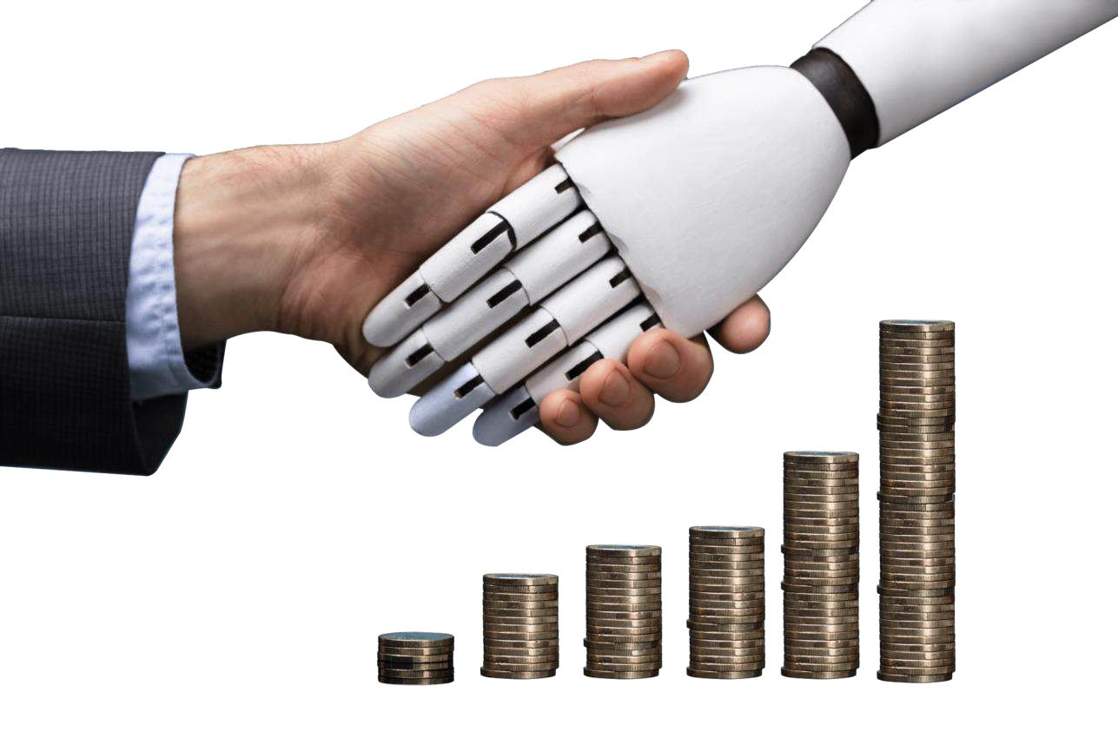
AI in Banking
AI-based systems to provide customer support, detect anomalies and credit card frauds.
An example of this is HDFC Bank & KOTAK Bank
AI can help banks minimize manual errors in data processing, analytics, document processing, onboarding, customer interactions, and other tasks through automation and algorithms that follow the same processes every single time.

Slide 24
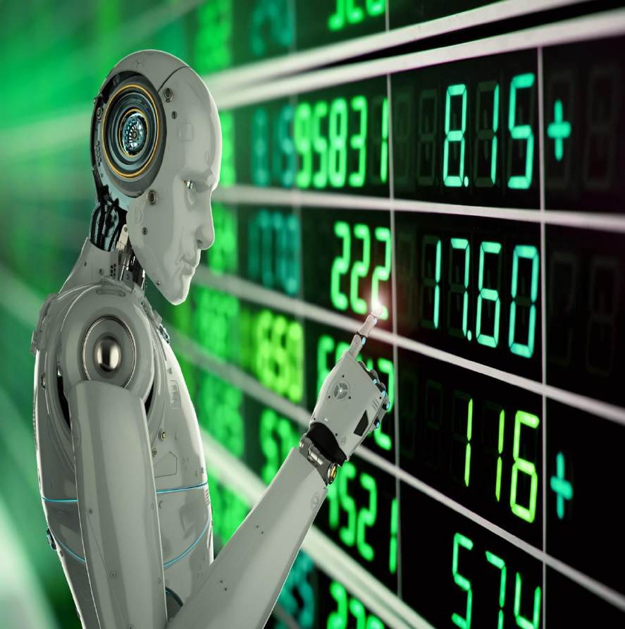
AI in Finance
The Financial organizations are turning to AI to improve their stock trading performance and boost profit.
AI in finance is the use of technology like machine learning (ML) that mimics human intelligence and decision-making to enhance how financial institutions analyze, manage, invest, and protect money.

Slide 25

AI in Agriculture
AI is transforming agriculture by offering solutions for precision farming, crop monitoring, and supply chain optimization.
AI-powered tools analyze data from various sources like drones, sensors, and satellite imagery to help farmers make informed decisions about irrigation, fertilization, and pest control.

Slide 26

AI in Health Care
AI in healthcare refers to the application of artificial intelligence technologies to improve various aspects of healthcare delivery, diagnosis, treatment, and research. AI can analyze vast amounts of medical data, identify patterns, and offer insights that can enhance patient care and streamline processes.

Slide 27
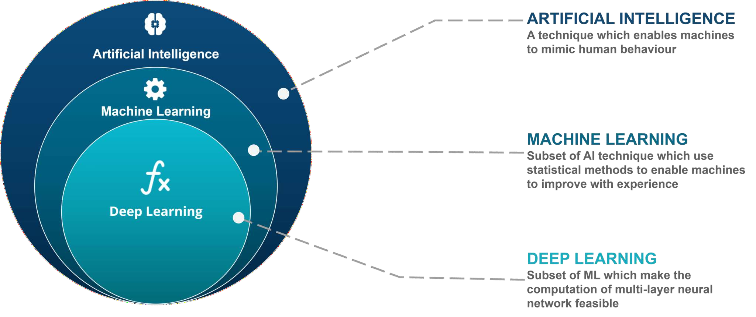
AI, Machine Learning, and Deep Learning

Slide 28
Machine Learning
“Machine Learning is a subset of artificial intelligence. It allows the machines to learn and make predictions based on its experience(data)“

Slide 29
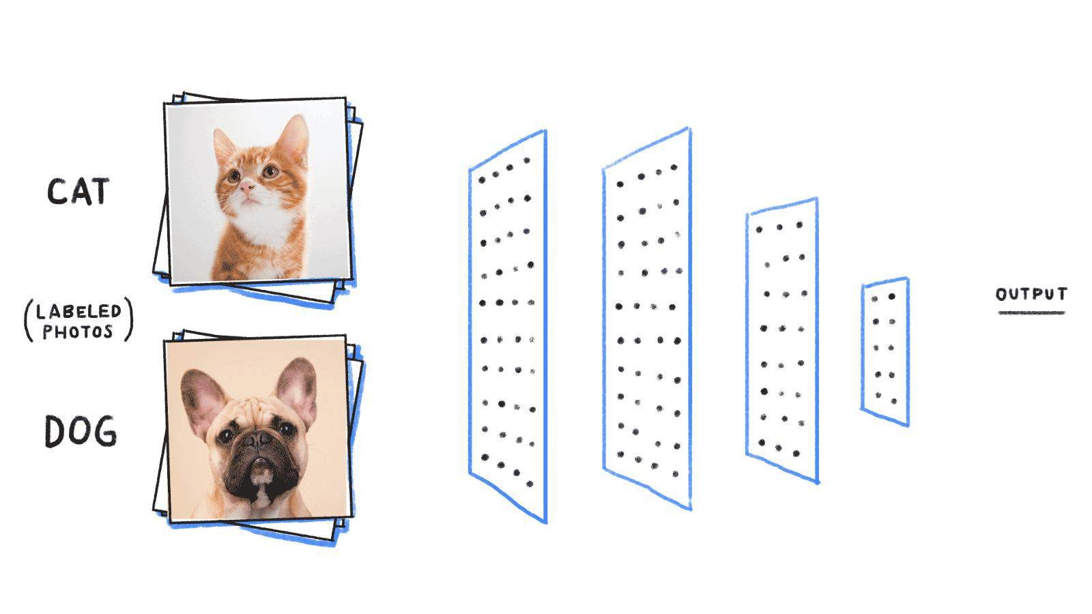
Deep Learning
Deep learning is a particular kind of machine learning that achieves great power and flexibility by learning to represent the world as nested hierarchy of concepts or abstraction”

Slide 30
The Birth of AI: 1950-1956
The genesis of Artificial Intelligence as a discernible field of study occurred in the early 1950s. This period was marked by the pioneering work of Alan Turing, a British mathematician and logician.
Alan Turing and the Turing Test: Alan Turing introduced the concept of machine intelligence in 1950 with his seminal paper "Computing Machinery and Intelligence," where he proposed a criterion of intelligence that came to be known as the Turing Test. The test was designed to evaluate a machine's ability to exhibit intelligent behavior equivalent to or indistinguishable from that of a human. Turing's ideas laid the groundwork for the development of artificial intelligence as a scientific discipline.
The Dartmouth Conference: The Dartmouth Conference in 1956 is often considered the birth of AI as a field. Organized by John McCarthy, Marvin Minsky, Nathaniel Rochester, and Claude Shannon, the conference brought together researchers interested in neural networks and the automation of intelligent behavior. It was at this conference that the term "Artificial Intelligence" was coined and adopted.

Slide 31
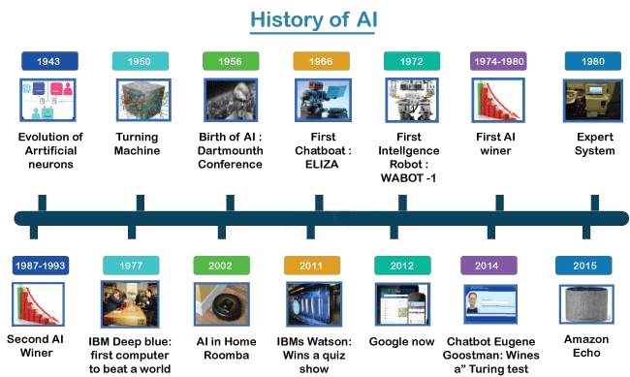
HISTORY OF AI

Slide 32
HISTORY OF AI
1921: Czech playwright Karel Čapek released a science fiction play “Rossum’s Universal Robots” which introduced the idea of “artificial people” which he named robots. This was the first known use of the word.
1929: Japanese professor Makoto Nishimura built the first Japanese robot, named Gakutensoku.
1949: Computer scientist Edmund Callis Berkley published the book “Giant Brains, or Machines that Think” which compared the newer models of computers to human brains.

Slide 33
4. 1950: Alan Turing published “Computer Machinery and Intelligence” which proposed a test of machine intelligence called “The Imitation Game”.
5. 1952: A computer scientist named ArthurSamuel developed a program to play checkers, which is the first to ever learn the game independently.
6. 1955: John McCarthy held a workshop at Dartmouth on “artificial intelligence” which is the first use of the word, and how it came into popular usage

Slide 34
AI maturation: 1957-1979
1958: John McCarthy created LISP (acronym for List Processing), the first programming language for AI research, which is still in popular use to this day.
1959: Arthur Samuel created the term “machine learning” when doing a speech about teaching machines to play chess better than the humans who programmed them.
1961: The first industrial robot Unimate started working on an assembly line at General Motors in New Jersey, tasked with transporting die casings and welding parts on cars (which was deemed too dangerous for humans).
1965: Edward Feigenbaum and Joshua Lederberg created the first “expert system” which was a form of AI programmed to replicate the thinking and decision-making abilities of human experts.
1966: Joseph Weizenbaum created the first “chatterbot” (later shortened to chatbot), ELIZA, a mock psychotherapist, that used natural language processing (NLP) to converse with humans.1968: Soviet mathematician Alexey Ivakhnenko published “Group Method of Data Handling” in the journal “Avtomatika,” which proposed a new approach to AI that would later become what we now know as “Deep Learning.”

Slide 35
1973: An applied mathematician named James Lighthill gave a report to the British Science Council, underlining that strides were not as impressive as those that had been promised by scientists, which led to much-reduced support and funding for AI research from the British government.
1979: James L. Adams created The Standford Cart in 1961, which became one of the first examples of an autonomous vehicle. In ‘79, it successfully navigated a room full of chairs without human interference.
1979: The American Association of Artificial Intelligence which is now known as the Association for the Advancement of Artificial Intelligence (AAAI) was founded.

Slide 36
AI boom: 1980-1987
Most of the 1980s showed a period of rapid growth and interest in AI, now labeled as the “AI boom.” This came from both breakthroughs in research, and additional government funding to support the researchers. Deep Learning techniques and the use of Expert System became more popular, both of which allowed computers to learn from their mistakes and make independent decisions.
Notable dates in this time period include:
1980: First conference of the AAAI was held at Stanford.
1980: The first expert system came into the commercial market, known as XCON (expert configurer). It was designed to assist in the ordering of computer systems by automatically picking components based on the customer’s needs.
1981: The Japanese government allocated $850 million (over $2 billion dollars in today’s money) to the Fifth Generation Computer project. Their aim was to create computers that could translate, converse in human language, and express reasoning on a human level.
1984: The AAAI warns of an incoming “AI Winter” where funding and interest would decrease, and make research significantly more difficult.
1985: An autonomous drawing program known as AARON is demonstrated at the AAAI conference.
1986: Ernst Dickmann and his team at Bundeswehr University of Munich created and demonstrated the first driverless car (or robot car). It could drive up to 55 mph on roads that didn’t have other obstacles or human drivers.
1987: Commercial launch of Alacrity by Alactrious Inc. Alacrity was the first strategy managerial advisory system, and used a complex expert system with 3,000+ rules.

Slide 37
AI winter: 1987-1993
As the AAAI warned, an AI Winter came. The term describes a period of low consumer, public, and private interest in AI which leads to decreased research funding, which, in turn, leads to few breakthroughs. Both private investors and the government lost interest in AI and halted their funding due to high cost versus seemingly low return. This AI Winter came about because of some setbacks in the machine market and expert systems, including the end of the Fifth Generation project, cutbacks in strategic computing initiatives, and a slowdown in the deployment of expert systems.
Notable dates include:
1987: The market for specialized LISP-based hardware collapsed due to cheaper and more accessible competitors that could run LISP software, including those offered by IBM and Apple. This caused many specialized LISP companies to fail as the technology was now easily accessible.
1988: A computer programmer named Rollo Carpenter invented the chatbot Jabberwacky, which he programmed to provide interesting and entertaining conversation to humans.

Slide 38
AI agents: 1993-2011
Despite the lack of funding during the AI Winter, the early 90s showed some impressive strides forward in AI research, including the introduction of the first AI system that could beat a reigning world champion chess player. This era also saw early examples of AI agents in research settings, as well as the introduction of AI into everyday life via innovations such as the first Roomba and the first commercially-available speech recognition software on Windows computers.
The surge in interest was followed by a surge in funding for research, which allowed even more progress to be made.
Notable dates include:
1997: Deep Blue (developed by IBM) beat the world chess champion, Gary Kasparov, in a highly-publicized match, becoming the first program to beat a human chess champion.
1997: Windows released a speech recognition software (developed by Dragon Systems).
2000: Professor Cynthia Breazeal developed the first robot that could simulate human emotions with its face,which included eyes, eyebrows, ears, and a mouth. It was called Kismet.
2002: The first Roomba was released.
2003: Nasa landed two rovers onto Mars (Spirit and Opportunity) and they navigated the surface of the planet without human intervention.

Slide 39
2006: Companies such as Twitter, Facebook, and Netflix started utilizing AI as a part of their advertising and user experience (UX) algorithms.
2010: Microsoft launched the Xbox 360 Kinect, the first gaming hardware designed to track body movement and translate it into gaming directions.
2011: An NLP computer programmed to answer questions named Watson (created by IBM) won Jeopardy against two former champions in a televised game.
2011: Apple released Siri, the first popular virtual assistant.

Slide 40
Artificial General Intelligence: 2012-present
That brings us to the most recent developments in AI, up to the present day. We’ve seen a surge in common-use AI tools, such as virtual assistants, search engines, etc. This time period also popularized Deep Learning and Big Data..
Notable dates include:
2012: Two researchers from Google (Jeff Dean and Andrew Ng) trained a neural network to recognize cats by showing it unlabeled images and no background information.
2015: Elon Musk, Stephen Hawking, and Steve Wozniak (and over 3,000 others) signed an open letter to the worlds’ government systems banning the development of (and later, use of) autonomous weapons for purposes of war.
2016: Hanson Robotics created a humanoid robot named Sophia, who became known as the first “robot citizen” and was the first robot created with a realistic human appearance and the ability to see and replicate emotions, as well as to communicate.
2017: Facebook programmed two AI chatbots to converse and learn how to negotiate, but as they went back and forth they ended up forgoing English and developing their own language, completely autonomously.

Slide 41
2018: A Chinese tech group called Alibaba’s language-processing AI beat human intellect on a Stanford reading and comprehension test.
2019: Google’s AlphaStar reached Grandmaster on the video game StarCraft 2, outperforming all but .2% of human players.
2020: OpenAI started beta testing GPT-3, a model that uses Deep Learning to create code, poetry, and other such language and writing tasks. While not the first of its kind, it is the first that creates content almost indistinguishable from those created by humans.
2021: OpenAI developed DALL-E, which can process and understand images enough to produce accurate captions, moving AI one step closer to understanding the visual world.

Slide 42
Agents in AI
A n A I system can be defined as the studyof the rational agent and its environment. What is an Agent?
“The agents sense the environment through sensors and act on their environment through actuators”.
An AI agent can have mental properties such as knowledge, belief, intention, etc .

Slide 43
Agents and Their Interaction with the Environment
An agent perceives its environment through sensors and acts upon it through actuators. There are different types of agents:
Types of Agents
1. Human Agent
- Sensors: Eyes, ears, and other sensory organs
- Actuators: Hands, legs, vocal tract
2. Robotic Agent
- Sensors: Cameras, infrared range finders, natural language processing (NLP)
- Actuators: Motors, mechanical limbs
3. Software Agent
- Sensors: Keystrokes, file contents, network packets
- Actuators: Display output on screen, write to files, send network packets
In each case, the agent uses its sensors to perceive the environment and its actuators to take action, enabling it to interact with and influence its surroundings.

Slide 44
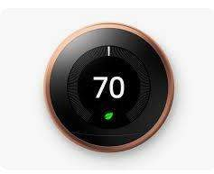

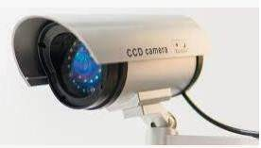
Examples of Agents

Slide 45
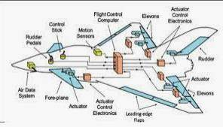
Fly by wire system
Fly-by-wire control systems allow aircraft computers to perform tasks without pilot input. Automatic stability systems operate in this way. Gyroscopes and sensors such as accelerometers are mounted in an aircraft to sense rotation on the pitch, roll and yaw axes.

Slide 46
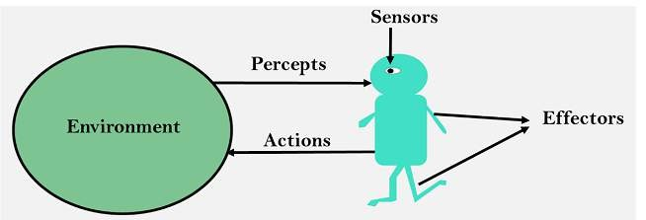
A Human-agent has eyes, ears, and other organs which act as sensors, and hands, legs, mouth, and other body parts act as actuators.

Slide 47
Components of Agents
Sensor: Sensor is a device which detects the change in the environment and sends the information to other electronic devices. An agent observes its environment through sensors.
Actuators: Actuators are the component of machines that converts energy into motion. The actuators are only responsible for moving and controlling a system. An actuator can be an electric motor, gears, rails, etc.
Effectors: Effectors are the devices which affect the environment. Effectors can be legs, wheels, arms, fingers, wings, fins, and display screen.

Slide 48
Good Behavior: The Concept of Rationality
Rational agent
A rational agent is one that does the right thing. Obviously, doing the right than doing the wrong thing, but what does it mean to do the right thing?
Rationality
What is rational at any given time depends on four things:
The performance measure that defines the criterion of success.
agent’s prior knowledge of the environment.
The actions that the agent can perform.
The agent’s percept sequence to date.

Slide 49
This leads to a definition of a rational agent:
“For each possible percept sequence, a rational agent should select an action that is expected to maximize its performance measure, given the evidence provided by the percept sequence and whatever built-in knowledge the agent has”

Slide 50
Intelligent Agent | Rational Agent
1. An Intelligent Agent is a system that can perceive its environment and take actions to achieve a specific goal. | 1. A Rational Agent is an Intelligent Agent that makes decisions based on logical reasoning and optimizes its behavior to achieve a specific goal.
2. An Intelligent Agent can perceive its environment through various sensors or inputs. | 2. A Rational Agent's perception is based on the information available to it and logical reasoning.
3. It can make decisions based on a set of rules or a pre- defined algorithm. | 3. It makes decisions based on logical reasoning and optimizes its behavior to achieve its goals.
4. An Intelligent Agent can learn from its environment and adapt its behavior. | 4. A Rational Agent can also learn from its environment and adapt its behavior, but it does so based on logical reasoning.
5. It can operate independently of human intervention. | 5. It can also operate independently of human intervention, but it does so based on logical reasoning.
6. An Intelligent Agent can be designed to achieve a specific goal. | 6. A Rational Agent has a specific goal and optimizes its behavior.

Slide 51
Why are rational agents important?
Real-world applications: Rational agents can be used to control autonomous systems such as self-driving cars, robots, or drones, to make financial decisions, or to plan logistics.
Optimization: Rational agents can optimize their behavior to achieve a specific goal, considering the current state of the environment, the available resources, and the constraints.
Decision-making: Rational agents can make decisions based on logical reasoning and optimize their behavior to achieve their goals, considering their perception of the environment and the performance measure; this allows for better decision- making.

Slide 52
Adaptability: Rational agents can learn from their environment and adapt their behavior. This allows them to improve their performance over time.
Autonomy: Rational agents can operate independently of human intervention. This can lead to increased efficiency and reduced human error.
Simulation: Rational agents can be used to simulate the behavior of other agents or systems, allowing for the study and prediction of their behavior.

Slide 53
Rational Agent Real-World Applications
Autonomous systems: Self-driving cars, drones, and robots use rational agents to make decisions, plan their actions and optimize their behavior to achieve their goals, such as safely transporting passengers or completing a task.
Finance: Rational agents are used in financial services to make investment decisions, risk management, and trading. They can analyze market data, predict future trends, and optimize their behavior to maximize returns.
Healthcare: Rational agents make medical diagnoses, plan treatment, and monitor patients' progress. They can analyze medical data, predict the progression of diseases, and optimize the treatment plan.
Manufacturing: Rational agents are used in manufacturing to control production processes, plan logistics, and optimize the use of resources.
Transportation: Rational agents are used in transportation to plan routes, schedule vehicles, and optimize
the use of resources.
Customer service: Rational agents interacting with customers, respond to their queries, and provide recommendations.
Social media: Rational agents are used to recommending content, filter spam, and moderate content.

Slide 54
The Nature of Environments
Now that we have a definition of rationality, we are almost ready to think about building rational agents.
We would try to study the “nature of the environment”.
The environment is the Task Environment (problem) for which the Rational Agent is the solution. Any task environment is characterised on the basis of “PEAS”.
We begin by showing how to specify a task environment, illustrating the process with a number of examples.
We then show that task environments come in a variety of flavors

Slide 55
Specifying the task environment
“PEAS”
Performance – What is the performance characteristic which would either make the agent successful or not.
Environment – Physical characteristics and constraints expected.
Actuators – The physical or logical constructs which would take action.
Sensors – Again physical or logical constructs which would sense the environment. From our previous example, these are cameras and dirt sensors.

Slide 56
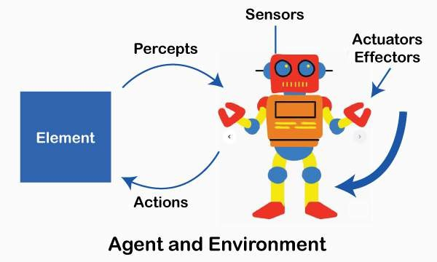

Slide 57
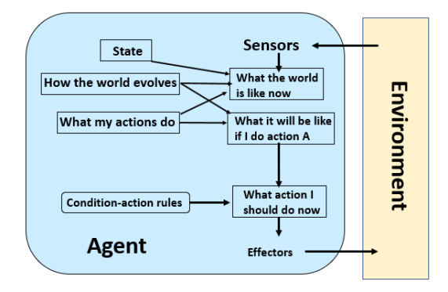

Slide 58
Rational Agents could be physical agents like the one described above or it could also be a program that operates in a non-physical environment like an operating system. Imagine a bot web site operator designed to scan Internet news sources and show the interesting items to its users, while selling advertising space to generate revenue.

Slide 59
Agent | Performance | Environment | Actuator | Sensor
Math E learning system | SLA defined score on the test | Student, Teacher, parents | Computer display system for exercises, corrections, feedback | Keyboard, Mouse

Slide 60
An automated taxi driver.
Figure 2.4 summarizes the PEAS description
for the taxi’s task environment. We discuss each element in more detail in the following paragraphs.

Slide 61
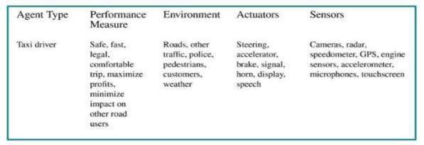

Slide 62
1. First, what is the performance measure
To which we would like our automated driver to aspire?
Desirable qualities include getting to the correct destination; minimizing fuel consumption and wear and tear; minimizing the trip time or cost; minimizing violations of traffic laws and disturbances to other drivers; maximizing safety and passenger comfort.
2. Next, what is the driving environment , that the taxi will face?
Any taxi driver must deal with a variety of roads, ranging from rural lanes and urban alleys to 12-lane freeways. The roads contain other traffic, pedestrians, stray animals, road works, police cars, puddles, and potholes. The taxi must also interact with potential and actual passengers.
3. The actuators for an automated taxi include those available to a human driver: control over the engine through the accelerator and control over steering and braking. In addition, it will need output to a display screen or voice synthesizer to talk back to the passengers, and perhaps some way to communicate with other vehicles, politely or otherwise

Slide 63
The basic sensors for the taxi will include one or more video cameras so that it can see, as well as lidar and ultrasound sensors to detect distances to other cars and obstacles. To avoid speeding tickets, the taxi should have a speedometer, and to control the vehicle properly, especially on curves, it should have an accelerometer.
Properties of task environments :
FULLY OBSERVABLE VS. PARTIALLY OBSERVABLE
SINGLE-AGENT VS. MULTIAGENT
Deterministic vs. nondeterministic
EPISODIC VS. SEQUENTIAL
STATIC VS. DYNAMIC
DISCRETE VS. CONTINUOUS
KNOWN VS. UNKNOWN

Slide 64
FULLY OBSERVABLE VS. PARTIALLY OBSERVABLE
Full or Partial? If the agents sensors get full access then they do not need to pre-store any information. Partial may be due to inaccuracy of sensors or incomplete information about an environment, like limited access to enemy territory
SINGLE-AGENT VS. MULTIAGENT :
The distinction between single-agent and multiagent environments may seem simple enough. For example, an agent solving a crossword puzzle by itself is clearly in a single-agent environment, whereas an agent playing chess is in a twoagent environment.
Deterministic vs. Non deterministic :
If the next state of the environment is completely determined by the current state and the action executed by the agent(s), then we say the environment is deterministic; otherwise, it is nondeterministic.

Slide 65
4. EPISODIC VS. SEQUENTIAL :
In an episodic task environment, the agent’s experienceis divided into atomic episodes. In each episode the agent receives a percept and then performs a singleaction. Crucially, the next episode does not depend on the actions taken in previous episodes. Many classification tasks are episodic.
STATIC VS. DYNAMIC
If the environment can change while an agent is deliberating, then we say the environment is dynamic for that agent; otherwise, it is static. Static environments are easy to deal with because the agent need not keep looking at the world while it is deciding on an action, nor need it worry about the passage of time
DISCRETE VS. CONTINUOUS
The discrete/continuous distinction applies to the state of the environment, to the way time is handled, and to the percepts and actions of the agent. For example, the chess environment has a finite number of distinct states (excluding the clock).

Slide 66
7.KNOWN VS. UNKNOWN
The distinction between known and unknown environments is not the same as the one between fully and partially observable environments. It is quite possible solitaire for a known environment to be partially observable—for example, in card games, I know the rules but am still unable to see the cards that have not yet been turned over. Conversely, an unknown environment can be fully observable—in a new video game, the screen may show the entire game state but I still don’t know what the buttons do until I try them.

Slide 67
The Structure of Agents
So far we have talked about agents by describing behavior—the action that is performe after any given sequence of percepts.
To understand the structure of Intelligent Agents, we should be familiar with Architecture and Agent programs.
Architecture : is the machinery that the agent executes on. It is a device with sensors and actuators, for example, a robotic car, a camera, and a PC.
An agent program is an implementation of an agent function. An agent function is a map from the percept sequence(history of all that an agent has perceived to date) to an action.
Agent=Architecture+Agent Program
f:P* → A

Slide 68
Agent programs
“An AI agent program is a software program that uses artificial intelligence (AI) to perform tasks, make decisions, and interact with its environment”
They take the current percept as input from the sensors and return an action to the actuators. Notice the difference between the agent program, which takes the current percept as input, and the agent function, which may depend on the entire percept history.
Agent programs are fundamental concepts that define how autonomous systems or agents perceive their environment and take actions to achieve specific goals. An agent can be a software entity (like a chatbot or a robot) that perceives its environment through sensors and acts upon it through actuators.

Slide 69
The agent program has no choice but to take just the current percept as input because nothing more is available from the environment; if the agent’s actions need to depend on the entire percept sequence, the agent will have to remember the percepts.
Now next question is, how to make agent work in proper order?
Taking the percept from environment and generating action based on environment.
How can we do this?
This can be done by good agent program.
There are two things to note about the skeleton of program,
generally, we recieve the agent mapping as a function, from percept sequence to action it just recieve only single input, if agent wants to recieve multiple percept, now it should have “specalized memory”

Slide 70
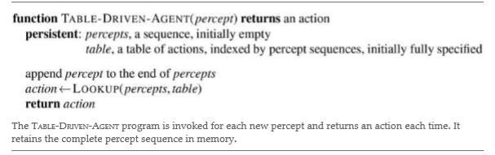
Now we have to design a agent progarm, that it should perform mapping function i.e AGENT TO PERCEPT (PROGRAM)

Slide 71
Four basic kinds of agent programs that embody the principles underlying almost all intelligent systems:
Simple reflex agents
Model-based reflex agents
Goal-based agents and
Utility-based agents.

Slide 72
Simple Reflex agent
The Simple reflex agents are the simplest agents. These agents take decisions on the basis of the current percepts and ignore the rest of the percept history. These agents only succeed in the fully observable environment.The Simple reflex agent does not consider any part of percepts history during their decision and action process.
The Simple reflex agent works on Condition-action rule, which means it maps the current state to action.
Such as a Room Cleaner agent, it works only if there is dirt in the room.

Slide 73
Problems for the simple reflex agent design approach:
They have very limited intelligence
They do not have knowledge of non-perceptual parts of the current state
Mostly too big to generate and to store.
Not adaptive to changes in the environment.

Slide 74
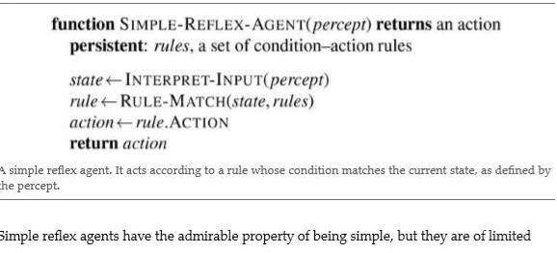

Slide 75
The Model-based
Agent can work in a partially observable environment, and track the situation.
A model-based agent has two important factors:
Model: It is knowledge about "how things happen in the world," so it is called a Model-based agent.
Internal State: It is a representation of the current state based on percept history.
These agents have the model, "which is knowledge of the world" and based on the model they perform actions.
Updating the agent state requires information about:
How the world evolves
How the agent's action affects the world.

Slide 76
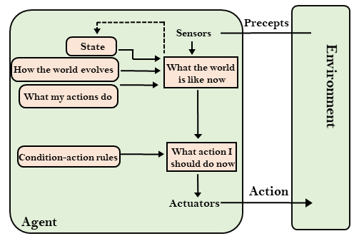
That is, the agent should maintain some sort of internal state that depends on the percept history and
thereby reflects at least some of the unobserved aspects of the current state.

Slide 77
Goal-based agents
The knowledge of the current state environment is not always sufficient to decide for an agent to what to do.
The agent needs to know its goal which describes desirable situations.
Goal-based agents expand the capabilities of the model-based agent by having the "goal" information.
They choose an action, so that they can achieve the goal.
These agents may have to consider a long sequence of possible actions before deciding whether the goal is achieved or not.
Such considerations of different scenario are called searching and planning, which makes an agent proactive.

Slide 78
Utility-based agents
These agents are similar to the goal-based agent but provide an extra component of utility measurement which makes them different by providing a measure of success at a given state.
Utility-based agent act based not only goals but also the best way to achieve the goal.
The Utility-based agent is useful when there are multiple possible alternatives, and an agent has to choose in order to perform the best action.
The utility function maps each state to a real number to check how efficiently each action achieves the goals.

Slide 79
A Problem-Solving Agent
In Artificial Intelligence, Search techniques are universal problem-solving methods. Rational agents or Problem-solving agents in AI mostly used these search strategies or algorithms to solve a specific problem and provide the best result.
Problem- solving agents are the goal-based agents and use atomic representation.
In general, “searching refers to as finding information one needs”.

Slide 80
Some of the most popularly used problem solving with the help of artificial intelligence are:
Chess.
Travelling Salesman Problem.
Tower of Hanoi Problem.
Water-Jug Problem.
N-Queen Problem.

Slide 81
Problem Searching
In general, searching refers to as finding information one needs.
Searching is the most commonly used technique of problem solving in artificial intelligence.
The searching algorithm helps us to search for solution of particular problem.

Slide 82
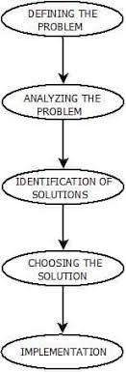
Steps : Solve Problem Using Artificial Intelligence
The process of solving a problem consists of five steps. These are:

Slide 83
Defining The Problem: The definition of the problem must be included precisely. It should contain the possible initial as well as final situations which should result in acceptable solution.
Analyzing The Problem: Analyzing the problem and its requirement must be done as few features can have immense impact on the resulting solution.
Identification Of Solutions: This phase generates reasonable amount of solutions to the given problem in a particular range
Choosing a Solution: From all the identified solutions, the best solution is chosen basis on the results produced by respective solutions.
Implementation : After choosing the best solution, its implementation is done.

Slide 84
Measuring problem-solving performance
We can evaluate an algorithm’s performance in four ways:
Completeness: Is the algorithm guaranteed to find a solution when there is one?
Optimality: Does the strategy find the optimal solution?
Time complexity: How long does it take to find a solution?
Space complexity: How much memory is needed to perform the search?

Slide 85
Search Algorithm Terminologies
Search: Searching is a step by step procedure to solve a search-problem in a given space. A search problem can have three main factors:
1. Search Space: Search space represents a set of possible solutions, which a system may have.
2. Start State: It is a state from where agent begins the search.

Slide 86
Search tree: A tree representation of search problem is called Search tree. The root ofthe search tree is the root node which is corresponding to the initial state.
Actions: It gives the description of all the available actions to the agent.
Transition model: A description of what each action do, can be represented as a transition model.
Path Cost: It is a function which assigns a numeric cost to each path.
Solution: It is an action sequence which leads from the start node to the goal node
Optimal Solution: If a solution has the lowest cost among all solutions.

Slide 87
Example Problems
A Toy Problem is intended to illustrate or exercise various problem-solving methods.
A real- world problem is one whose solutions people actually care about.

Slide 88
Toy Problems Vacuum World
States: The state is determined by both the agent location and the dirt locations. The agent is in one of the 2 locations, each of which might or might not contain dirt. Thus there are 2*2^2=8 possible world states.
Initial state: Any state can be designated as the initial state.
Actions: In this simple environment, each state has just three actions: Left, Right, and Suck. Larger environments might also include Up and Down.
Transition model: The actions have their expected effects, except that moving Left in the leftmost squ are, moving Right in the rightmost square, and Sucking in a clean square have complete state space is shown in Figure.
Goal test: This checks whether all the squares are clean.
Path cost: Each step costs 1, so the path cost is the number of steps in the path.

Slide 89
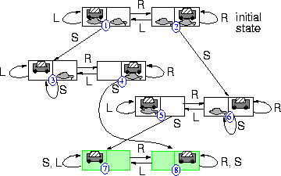
VACCUM WORLD STATE SPACE GRAPH

Slide 90
Problem formulation
Problem formulation is a critical step in AI that shapes how an algorithm interacts with its environment, how it perceives its goal, and the actions it can take to achieve that goal. A well- formulated problem provides:
Initial State: The starting point or condition from which the AI will begin solving the problem.
Actions: The set of possible moves or steps the AI can take to transition from one state to another.
Goal State: The desired outcome or final state the AI aims to achieve.
Path Costs: Costs associated with moving between states. These could be time, distance, energy, or other metrics depending on the problem context.

Slide 91
City Map Example: Pathfinding AI
Imagine we are developing an AI to find the shortest route between two points in a city, represented as a city map. The problem can be formulated as a pathfinding task, where the AI agent needs to travel from a starting point (initial state) to a destination (goal state) by selecting the best route based on some criteria like distance or time.

Slide 92
Key Components of Problem Formulation
Initial State: The location on the city map where the agent (AI) starts. For example, the initial state could be Point A (e.g., your home).
State Space: All possible locations on the city map, representing intersections, roads, and landmarks. Each point on the map is a state.
Actions: The possible moves the agent can make from one location to another. For instance, the AI might choose to move north, south, east, or west between different intersections or roads on the map.
Transition Model: Defines the result of each action. For example, if the AI decides to move north, it will land at the next intersection in that direction, updating its state.
Goal State: The destination where the agent wants to arrive, such as Point B (e.g., a restaurant or office).
Path Cost: A numerical value associated with traveling between two points
The AI could minimize the distance (shortest path) or the time (fastest path considering traffic or road conditions). Path costs help the AI decide which moves are optimal.

